Slide 1


Reasoning on Knowledge Graphs: Symbolic or Neural?
Meng Qu^{1,2}, Zhaocheng Zhu^{1,2}, Jian Tang^{1,3,4}
Mila-Quebec AI Institute¹
University of Montreal²
CIFAR AI Chair³, HEC Montreal⁴
Feb 23, 2022

Slide 2
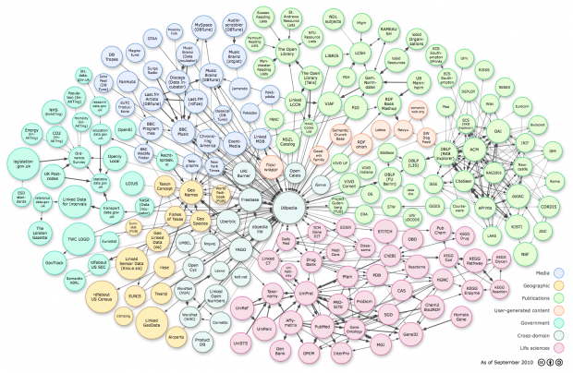
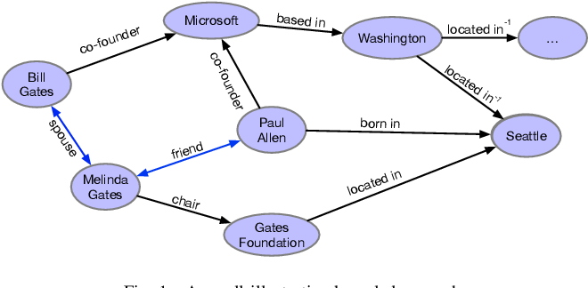
Knowledge Graphs
Knowledge graphs are heterogeneous graphs
Multiple types of relations
A set of facts represented as triplets
(head entity, relation, tail entity)

Slide 3
Recommendation in E-commerce
Suggest relevant items to users
Hongwei Wang et al. RippleNet: Propagating user preferences on the knowledge graph for recommender systems. CIKM 2018.

Slide 4
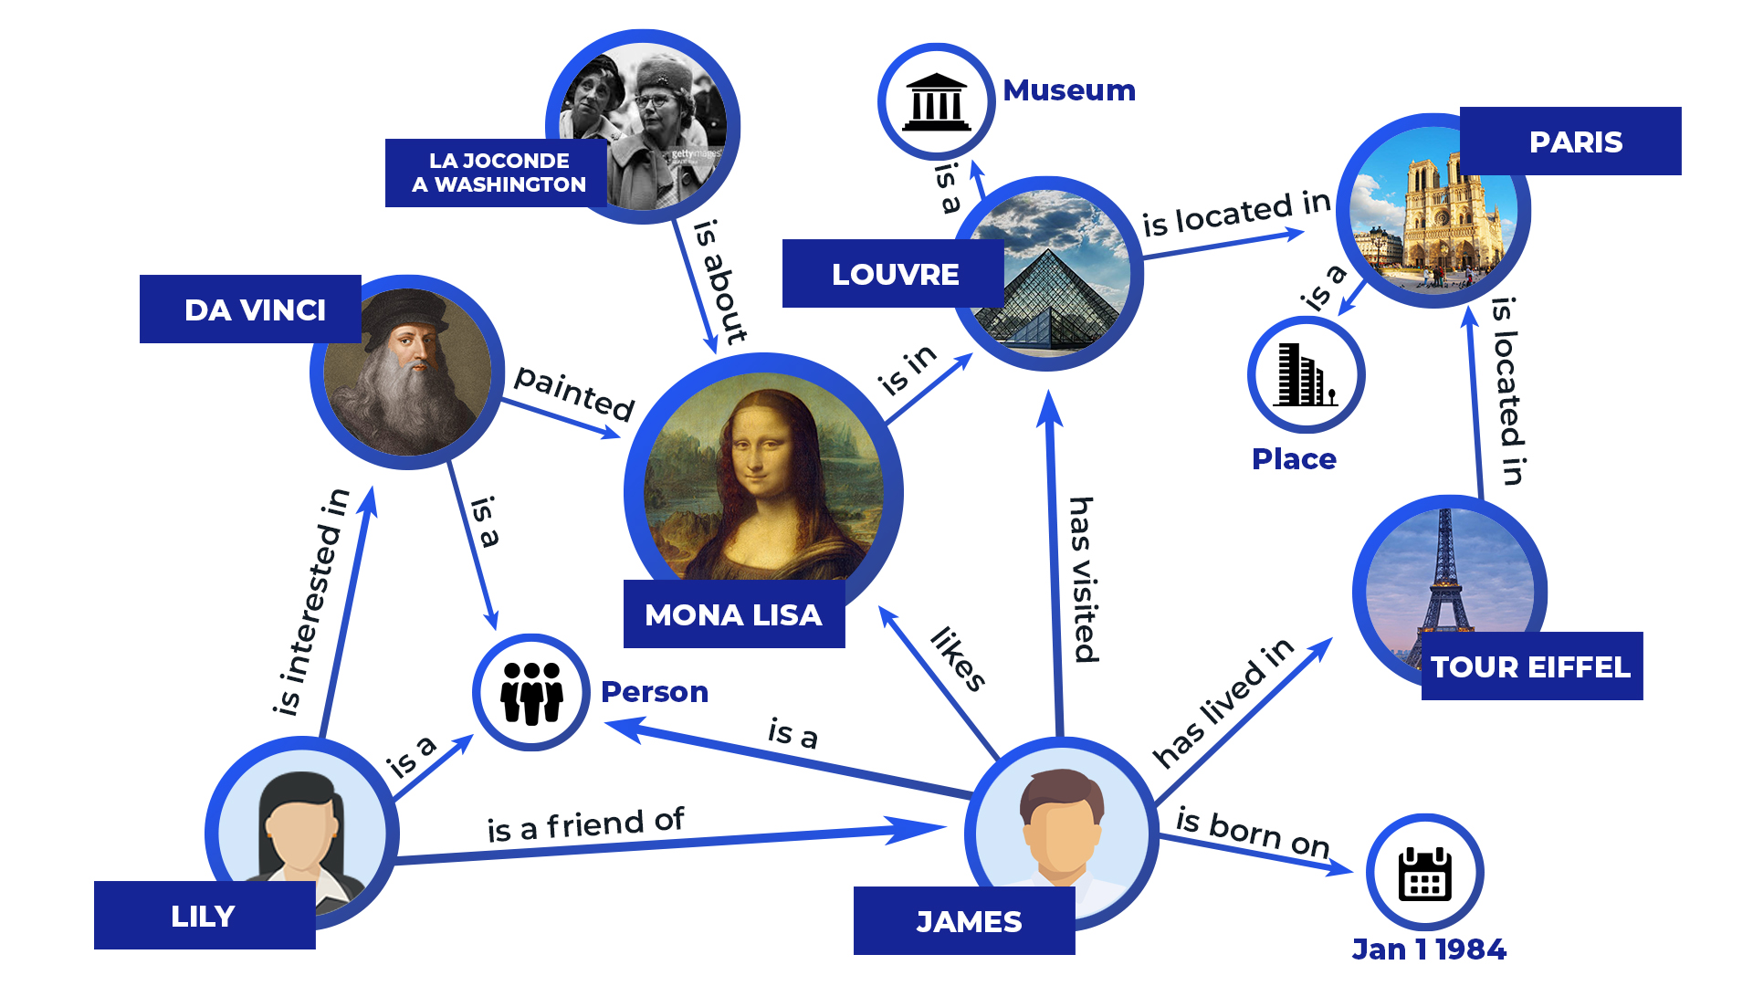
Question Answering
Question: “What are all the country capitals in Africa?”

Slide 5
Drug Repurposing
Predicting effective (approved) drugs given a disease
Xiangxiang Zeng et al. Repurpose open data to discover therapeutics for COVID-19 using deep learning. Journal of proteome research 2020.

Slide 6
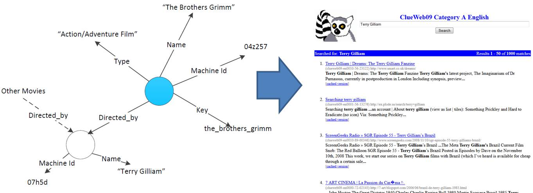
Information Retrieval
Knowledge graphs are used to understand the meanings of query terms and identify documents that match the meanings
Figure from http://www.cs.cmu.edu/~callan/Projects/IIS-1422676/

Slide 7
Reasoning on Knowledge Graphs
Knowledge graphs are usually incomplete. Many facts are missing
A fundamental task: predicting missing links (or facts) by reasoning on existing facts
The Key Idea: leverage logic rules for reasoning on knowledge graphs implicitly or explicity
Example:
Barack_Obama BornIn United_States
Parents of Parents are Grandparents
Barack_Obama Nationality American

Slide 8
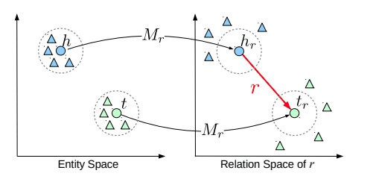
Reasoning in Continuous Space
Knowledge graph embedding methods
Map entities and relations into continuous space, and reasoning in the continuous spaces
TransE, TransH, TransR, ComplEx, RotatE, ….
TransE
TransR
RotatE

Slide 9
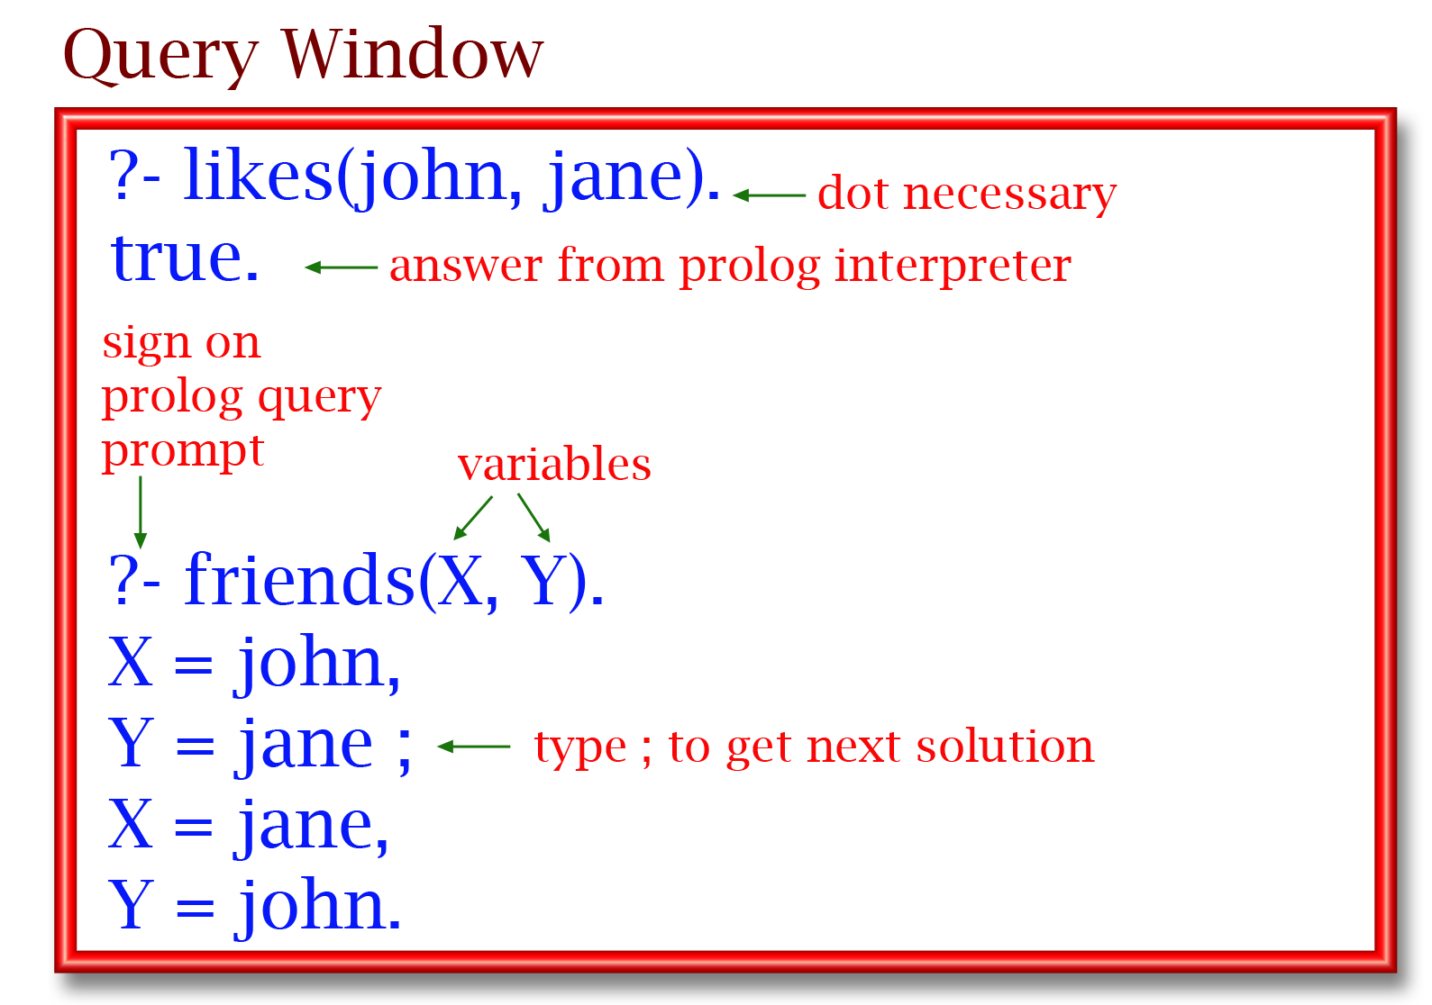
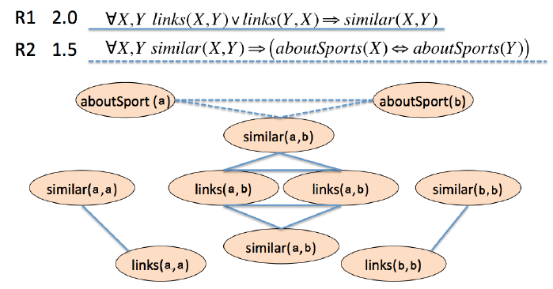
Reasoning in Symbolic Space
Symbolic logical rule based methods
Logic programming (e.g., Prolog)
Markov Logic Network
….
Markov Logic Networks
Prolog

Slide 10
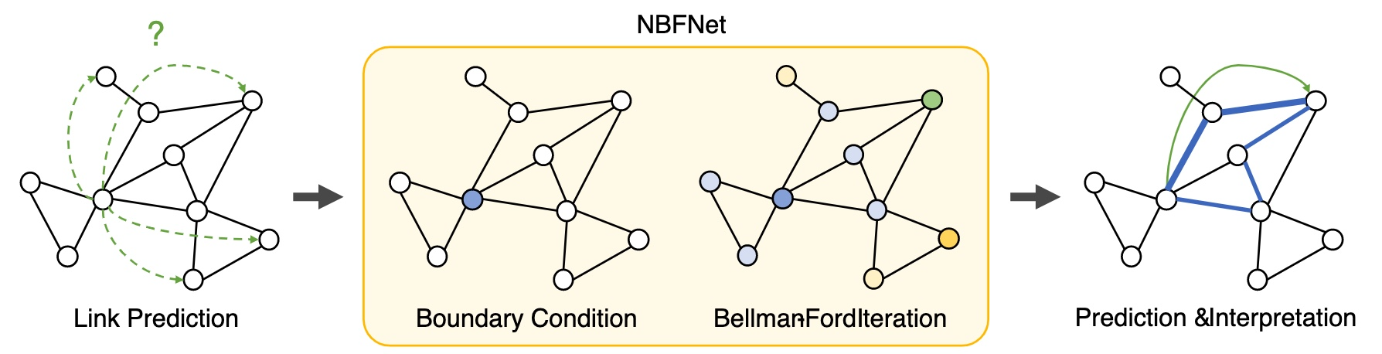
Neural-Symbolic Reasoning
Combining neural approaches and symbolic approaches
Better capacity and interpretability
pLogicNet (Qu and Tang, 2019)
NBFNet (Zhu et al. 2021)
pLogicNet
NBFNet

Slide 11
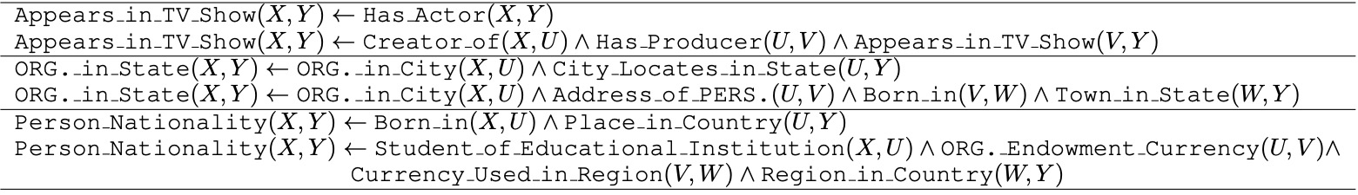
Logical Rule Induction/Learning
Logical rules are usually not available, how to infer logical rules from knowledge graphs?
Inductive logic programming
Neural logic programming

Slide 12
Roadmap
Part I: Neural Methods
Part II: Symbolic Logic Methods
Part III: Neural-Symbolic Methods
Part IV: Logic Rule Induction Methods
Part V: Summary and Future Directions

